Slide 1
Training Journey
Blue Print

Slide 2
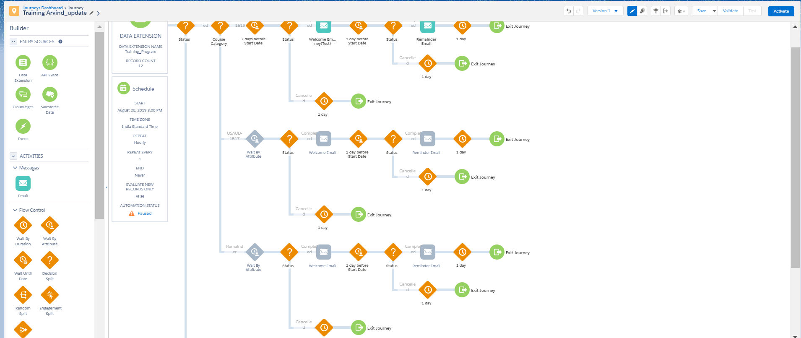

Slide 3
Step 1
Data will be shared by Training Team on FTP.
Import activity to put the file from FTP to Marketing Cloud Data Extension.

Slide 4
Step 2
Master Template will be created that will fetch the information from DE on the basis of Email address and Course number.

Slide 5
Step 3
We will Check the status of Subscriber if it is confirmed then it will go to next step
Else
Journey will Stop

Slide 6
Step 4
Once Step 3, succeeds then we will put condition on the basis of Course Category (like different Course Name )
For Example:-
Driving Strategy- Your Story (DSYS Facilitator Guide-Supplement is sent as attachment)
Audit & Assurance Year 5 (AY5_Agenda is sent as attachment)
Audit & Assurance Year 4 (AY4_Participant Agenda is sent as attachment)
Statement of Cash Flows Virtual session

Slide 7
Step 5
Wait Period will depend on Course type.
Let suppose, if we want to send the welcome email for Driving Strategy- Your Story 7 days prior to start date.
and
For Audit & Assurance Year 5 wait period is 5 days prior to start date.

Slide 8
Step 6
We will check status once again, if any new subscriber register then they will also receive the email.
or
If Someone cancelled prior to sent date or on sent date then they will not receive any email.

Slide 9
Step 7
One Day before, we will send a Reminder Email.
Why we are sending Reminder Email?
In case if any subscriber cancelled the training or in case if there is any change from our side.

